Slide 1
JUSTIN CUI
T1A2 - Portfolio

Slide 2
Agenda
Thoughts, Process
Inspirations
Sitemap, Color Palette
Page Features
Snippets of code
Challenges
Site Walkthrough (if time permits)

Slide 3
Thoughts, Decisions and the Process
Thoughts
Simple Site Nav and easily accessible to professional links
Use of mainly flexbox for ease of responsive layout of containers.
How to incorporate personality skills/or interests into design.
Decisions and Process
Started with HTML and CSS before the wireframes to ensure that i could translate it into code.
Color palette chosen based on a night theme and contrasting yellow / white lights after the general layout and design idea was decided from checking out websites to complement images to be used.
A lot of research, trial and error especially with alignment and being able to incorporate correct CSS selectors correctly.

Slide 4
Inspirations
Ambient Night lights
Small Streets of Japan
Mood lighting
Lights and Shadows

Slide 5
All photos and images used credited to Masahi Wakui
https://www.flickr.com/people/megane_wakui/

Slide 6
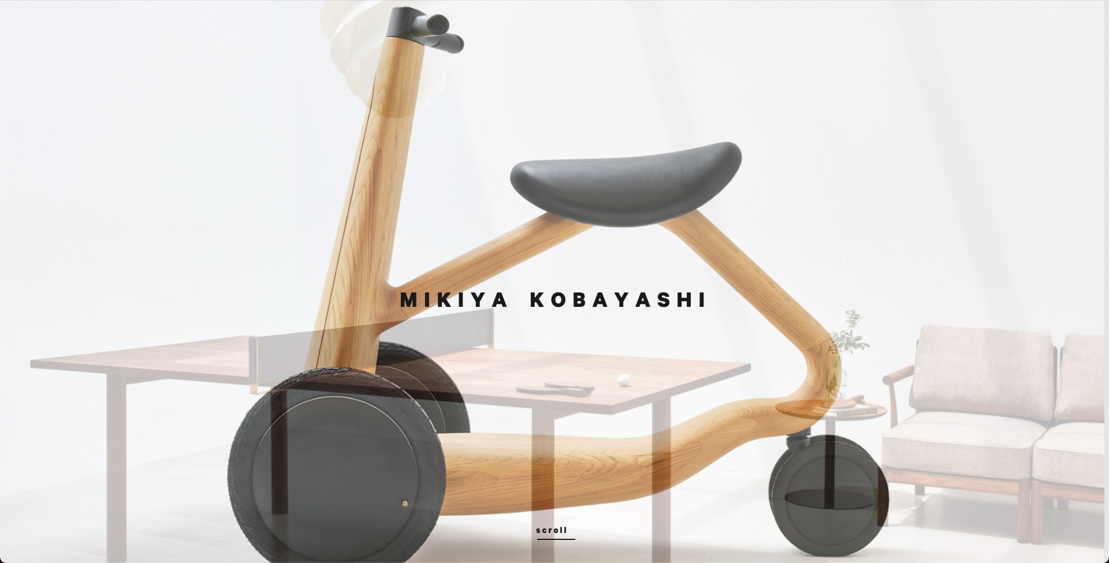
How does the density of an object affect its ability to float?
http://www.mikiyakobayashi.com/

Slide 7
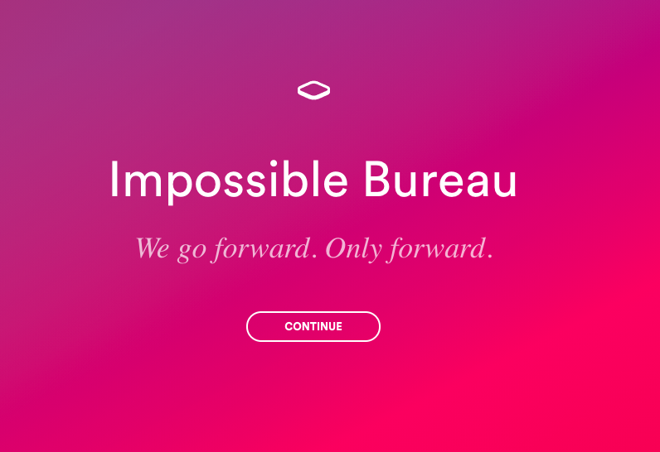
http://www.impossible-bureau.com/

Slide 8
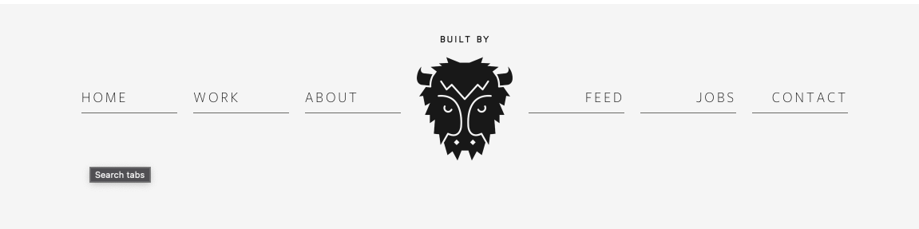
https://builtbybuffalo.com/

Slide 9
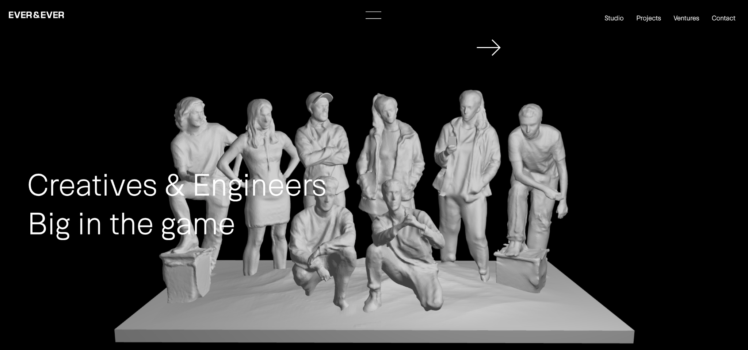
https://www.everandever.co/

Slide 10

SITE MAP
index.html
about.html
projects.html
blog.html
contact.html
All pages are navigable via nav bar at top of each page. J.C Logo acts as attention grabber and hyperlinked to index.html

Slide 11




Color Palette Used So Far
#141414
#C1D649
#D6FA0B
#212121

Slide 12
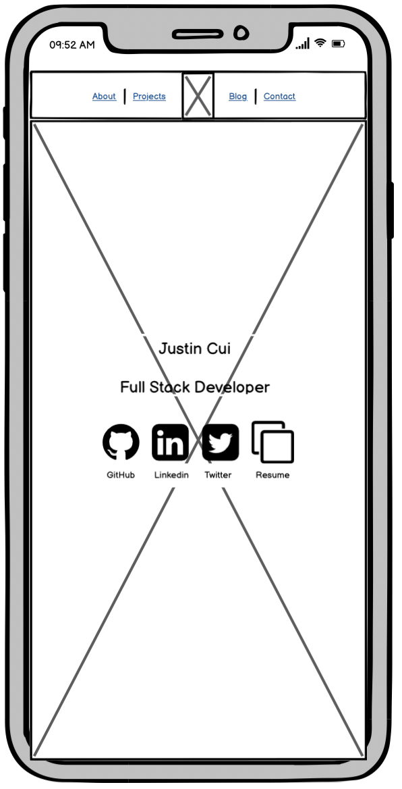
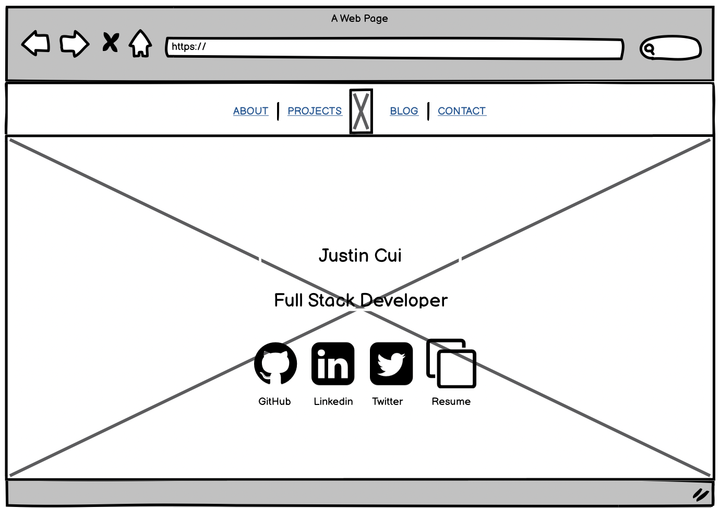
Universal Features
Features
Navigation Panel
Flex row + Justify/Align : center
Opacity reduced
:hover effect to bring opacity back
Z-index : 1 to allow to appear in front of scrolling content
Position is fixed to keep nav bar within viewport when scrolling
Navigation Links (Styled Text Content)
Text Shadow - to create glow
Resize font size when viewport hits 660px and 415px.
Bullet points removed through text-decoration / underline removed
Logo in navigation (Styled Graphical Content)
Initial opacity set to 0 - e.g. non visible
“Breathing” effect done via @keyframes + animation targeting opacity + infinite iteration count
Hyper-linked to go to home page
Resizes at 660px;
Font Family
Firago Font Family installed and hosted
Background Image (Styled Graphical Content)
Background Image set to cover the whole page with no repeat and fixed to scroll.
Linear gradient towards top to blend with nav panel

Slide 13
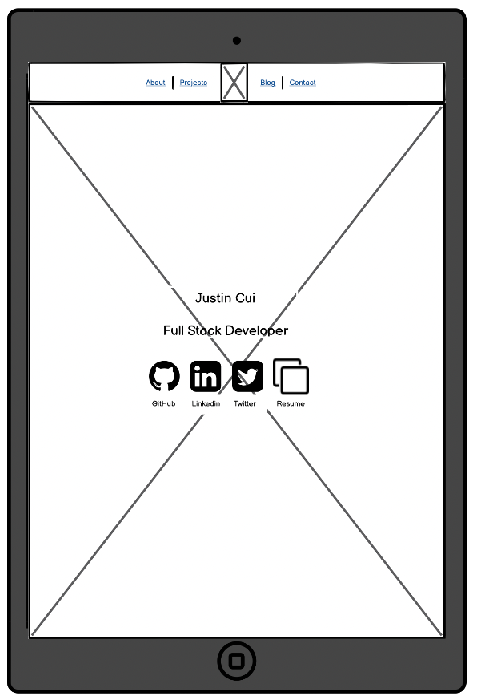
Home
Features
Name and Job Title (Styled Text Content)
Flex row + Justify/Align : center
Individual divs for each letter to allow for fadein animation delay to target each letter
Text Shadow - to create glow
Resizes when viewport hits 800px
Socials Containers (Styled Graphical Content)
Flex + Justify: center
:hover effect to grow in size
:after pseudo for the names of each social icon
Text Shadow - to create glow effect on :after text
Each one an individual jpg file.

Slide 14
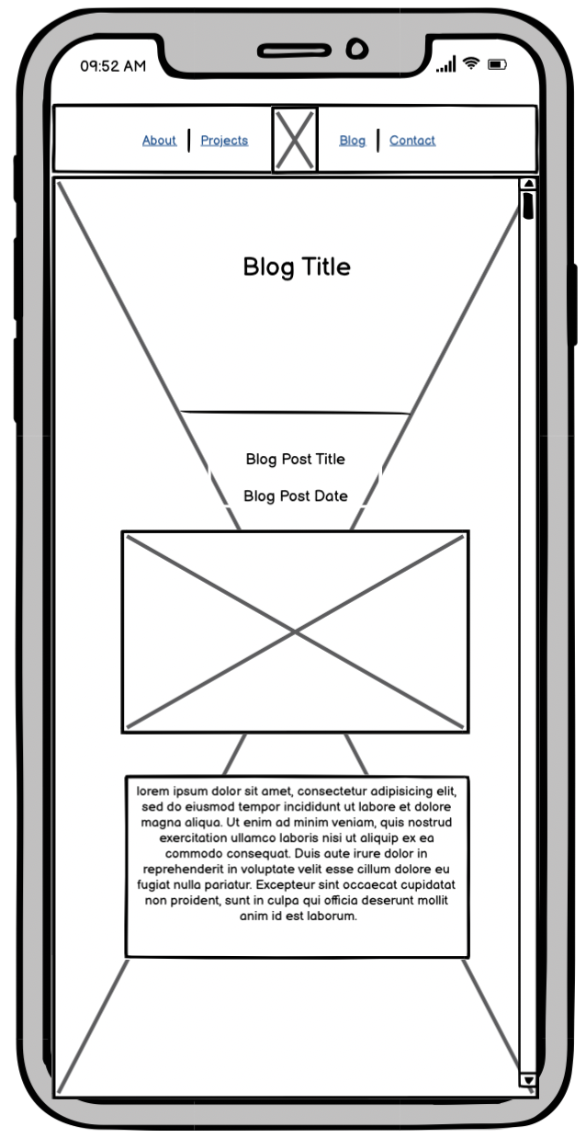
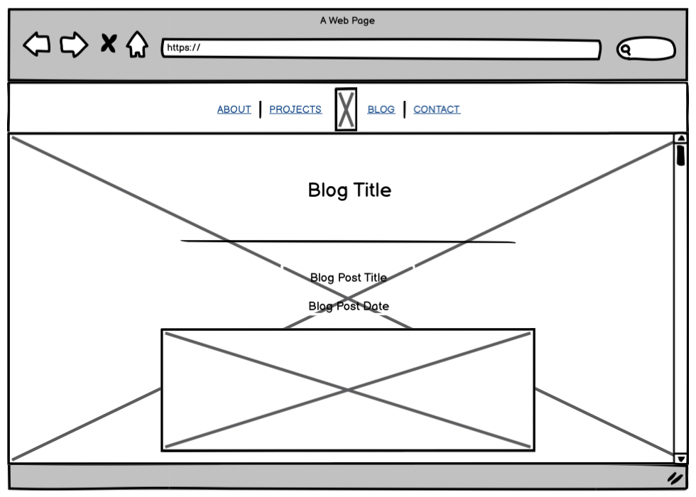
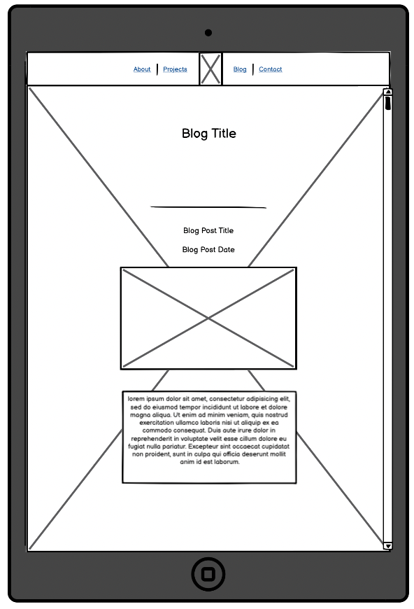
Blog
Features
Blog Post Separators
Divs at 2px height with a border radius set at 100% to apply the “sharp on outside round in the middle” looks
Border-shadow to go with text-shadow (neon lights theme)multiple layers at different pixel sizes applied for glow effect
Blog Post Image (Styled Graphical Content)
Image is in a wrapper with border radius at 30px for rounded edges. Overflow is set to hidden. Idea was to try and keep images the same size-ish on the blog and allow for hover effect to zoom
:hover effect on image inside wrapper to scale up
Text background (Styled Text Content)
Applied a slight background with 0.5 opacity for readability against background image
Blog Container
Applied Flexbox, to align all items within container to center to provide symmetry.

Slide 15
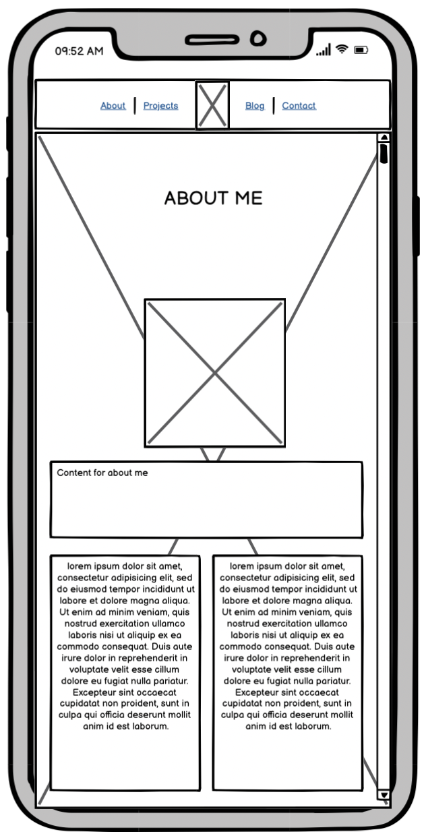
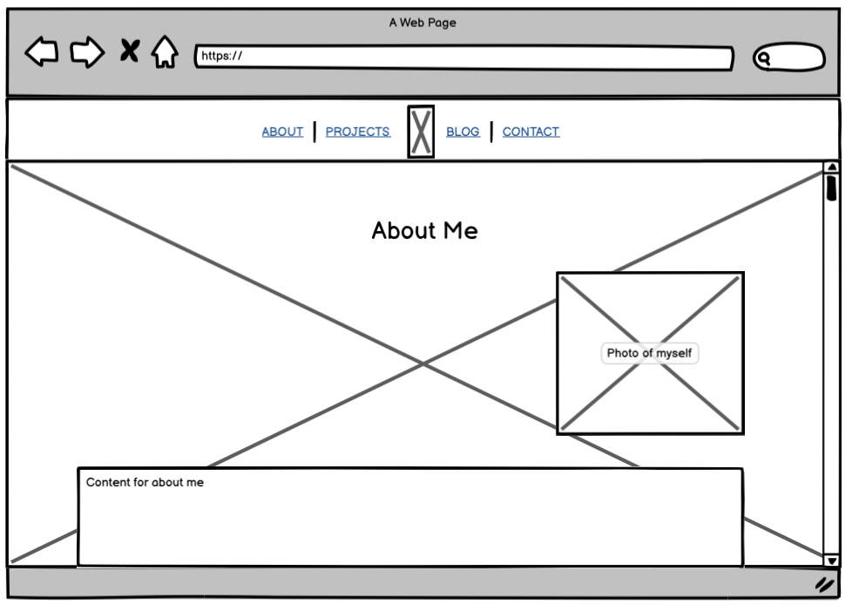
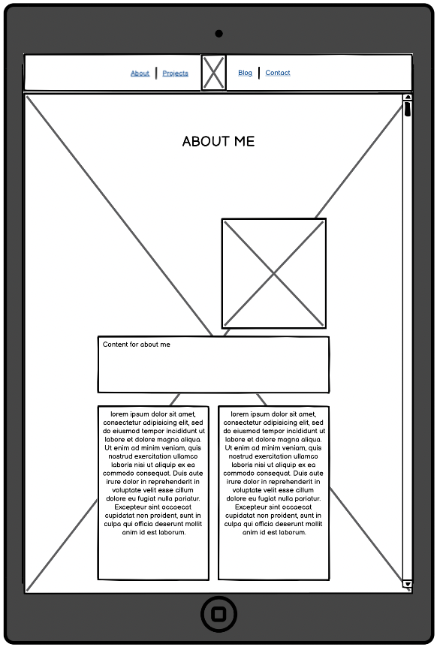
About Me
Features
Profile Photo (Styled Graphical Content)
Circular Clip Path on photo
Resize at 750px viewport width
Centers at 750px viewport width
Top Div for About me Blur
Flexbox used with Justify content to flex start.
Container spreads across 80% of the viewport to allow for readability
Background in place with opacity applied for text readability
Text will resize for responsive design
Columns for About Me
2 Columns created via Column Divs, flex box and flex direction and width set at 40% each of parent container
Lists display: either inline-block or standard depending on the content.
Background in place with opacity applied for text readability
Text will resize for responsive design

Slide 16
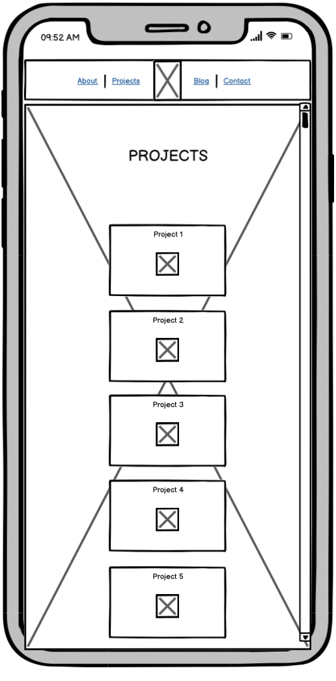
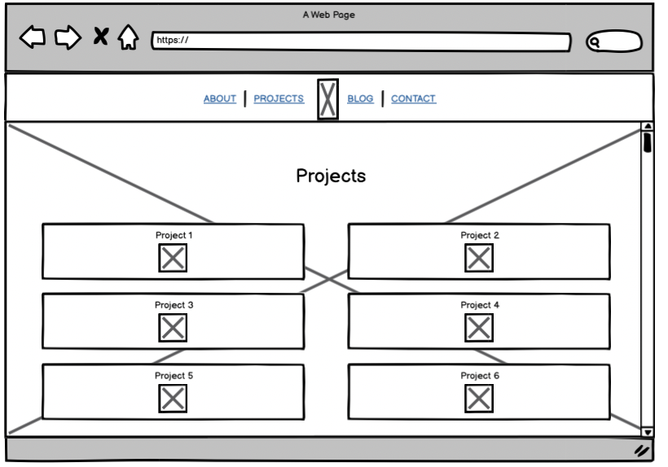
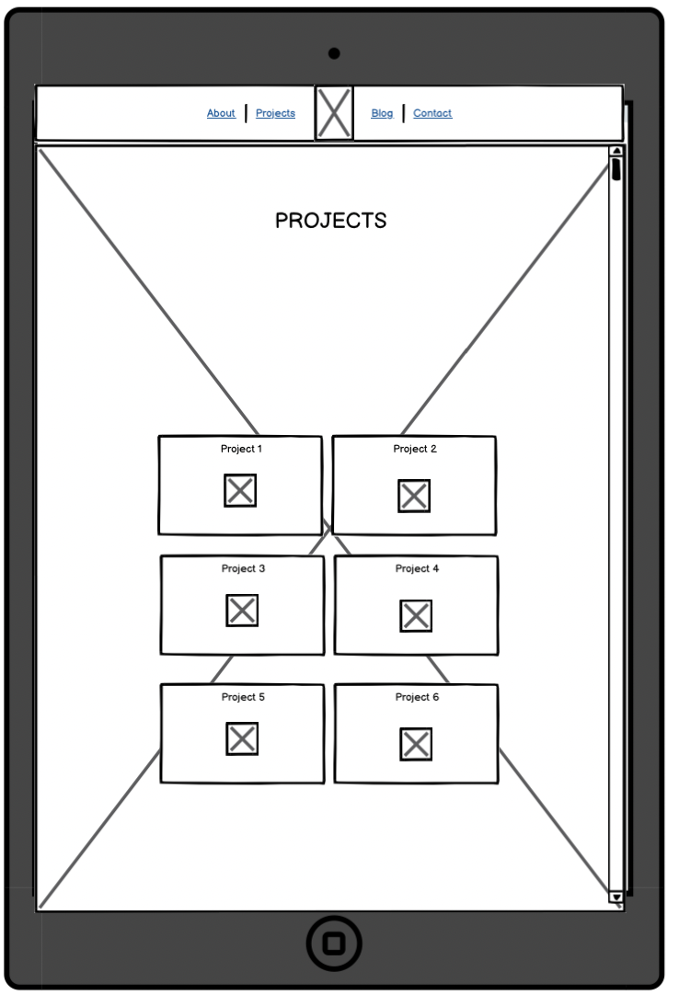
Projects
Features
Project Cards
Created with Flexbox and padding
Icons / image of project to be added to each card
:hover effect to enlarge project icon
Icon hyperlinked to project pages

Slide 17
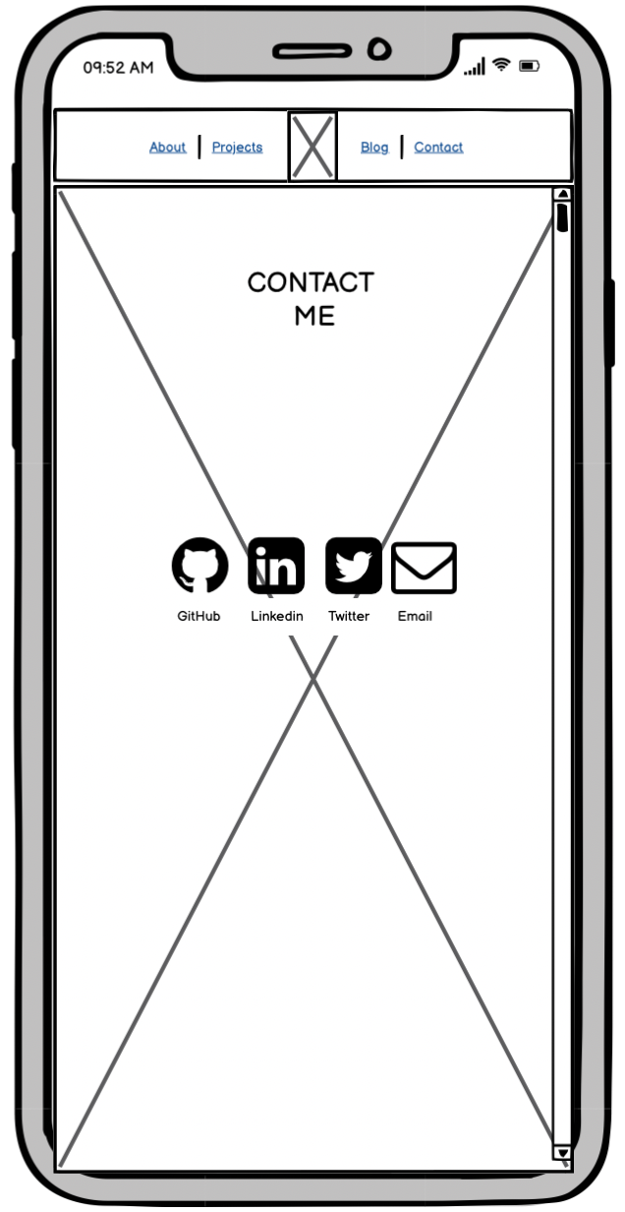
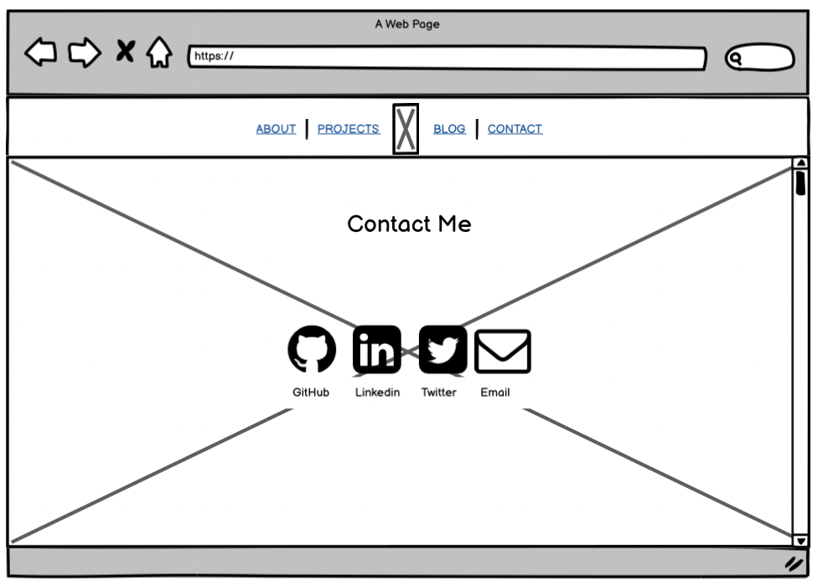
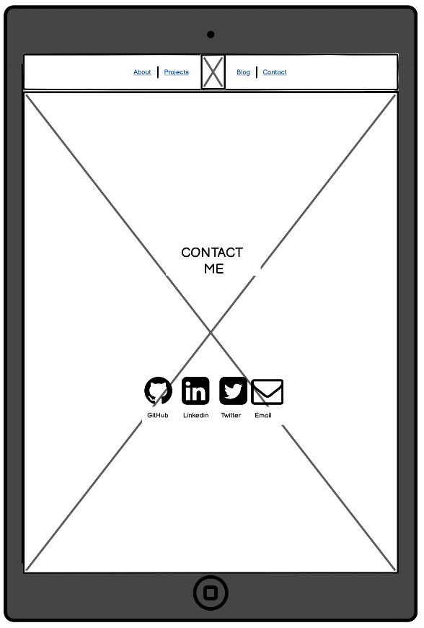
Contact Me
Features
Socials Containers (Styled Graphical Content)
Flex + Justify: center
:hover effect to grow in size
:after pseudo for the names
Text Shadow - to create glow effect on :after text
Each one an individual jpg file.
Mailto link on email anchor.

Slide 18
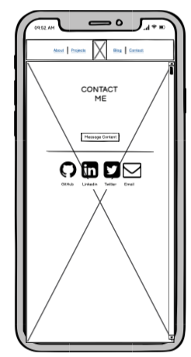
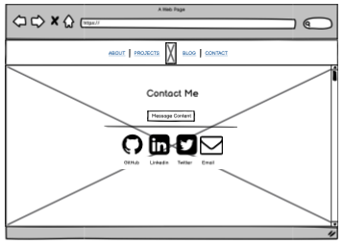
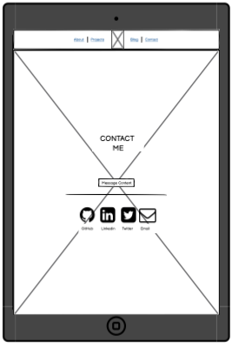
Contact Me - Revision
Features
Added additional Container for Text
Added additional light bar for theme

Slide 19
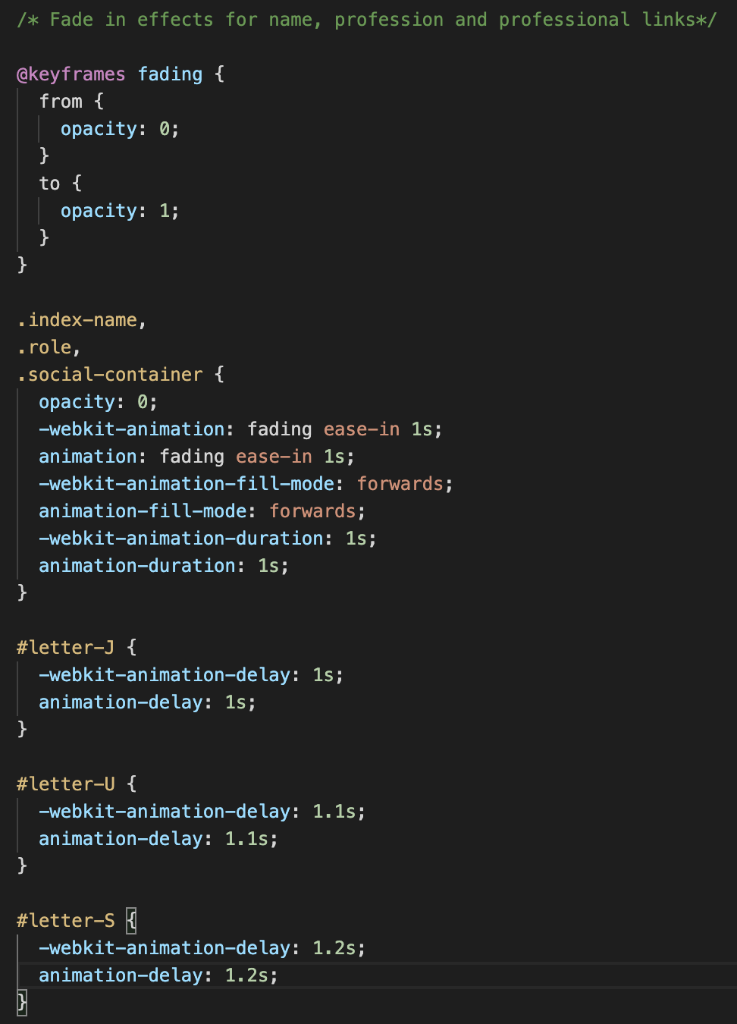
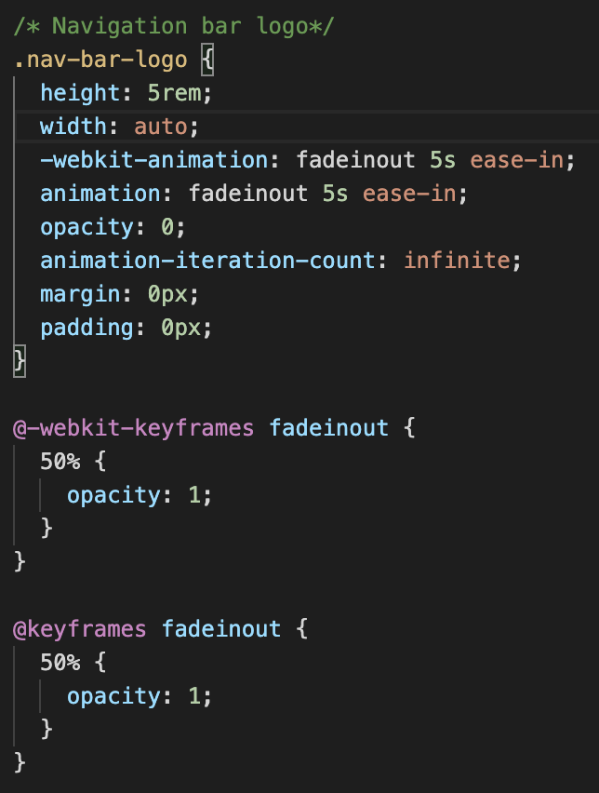
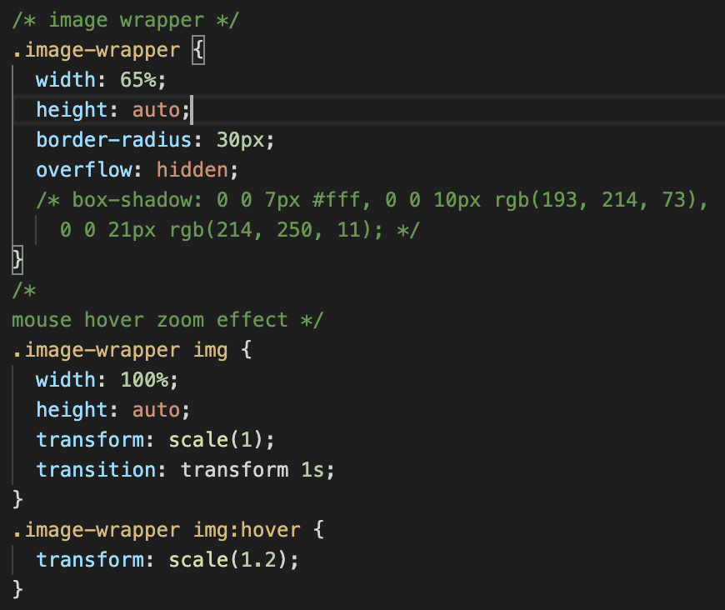
Notable Styling Pieces
CSS that applies Delayed fade in on Homepage
CSS that applies “breathing” effect on logo
CSS that applies blog image wrapping + zoom effect on hover

Slide 20
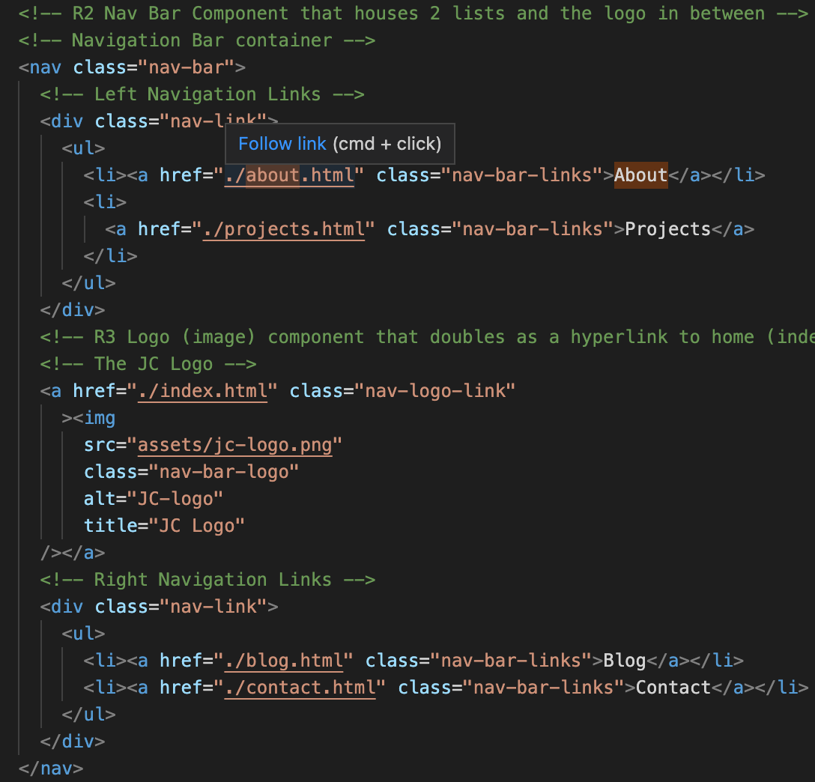
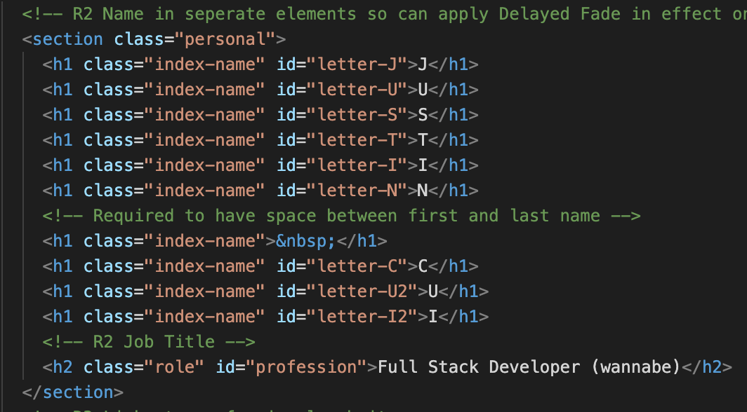
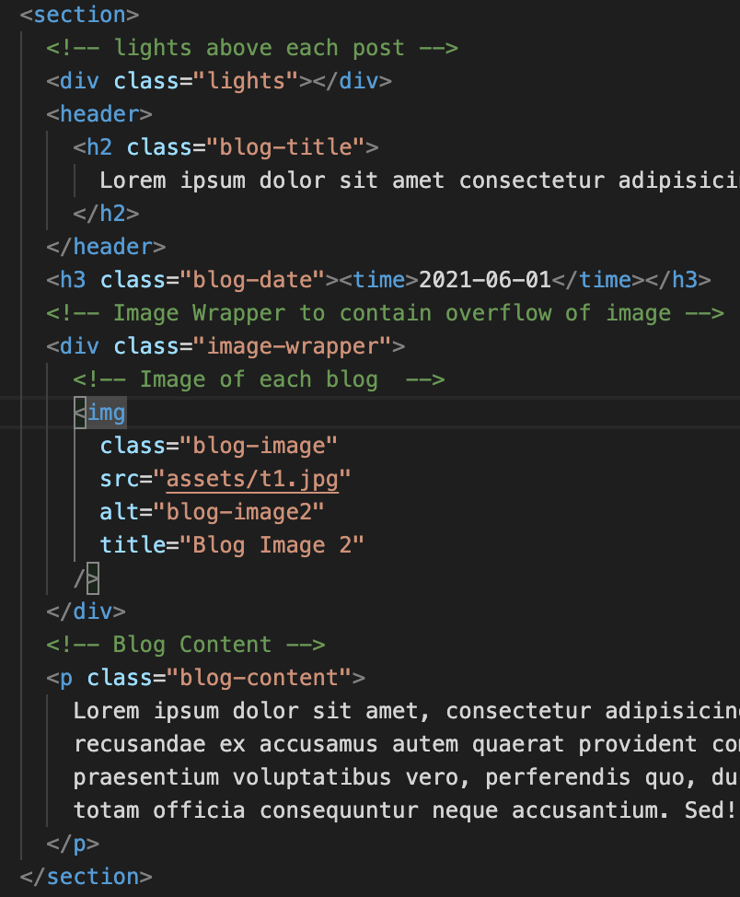
Notable HTML Pieces
Nav Bar broken into three sections
Blog post light bar, image wrapper to compliment zoom overflow
Name and job title on home page

Slide 21


Audience Engagement
Delayed animations on center aligned content used on Main Page on load to grab audience attention
Mouse over icon effect to scale up in size for interactivity of audience

Slide 22
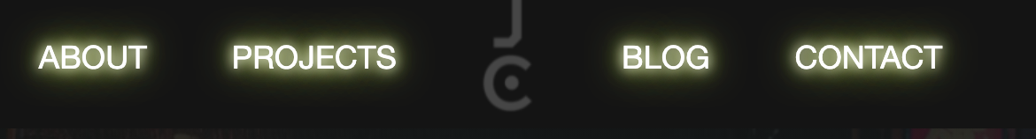
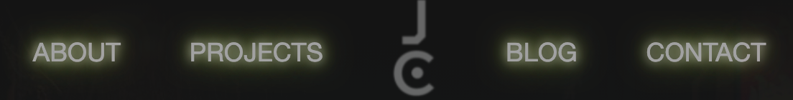


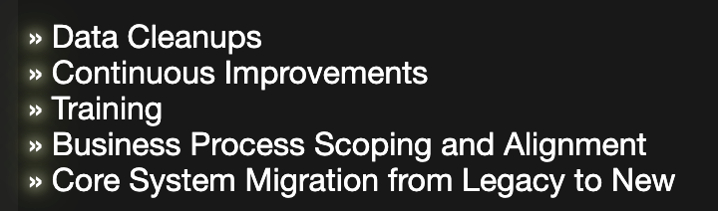
Audience Engagement
Neon theme(personality)incorporated across website
Opacity reduced on nav-bar when static to blend into background image
Upon mouse over, opacity = for clarity

Slide 23
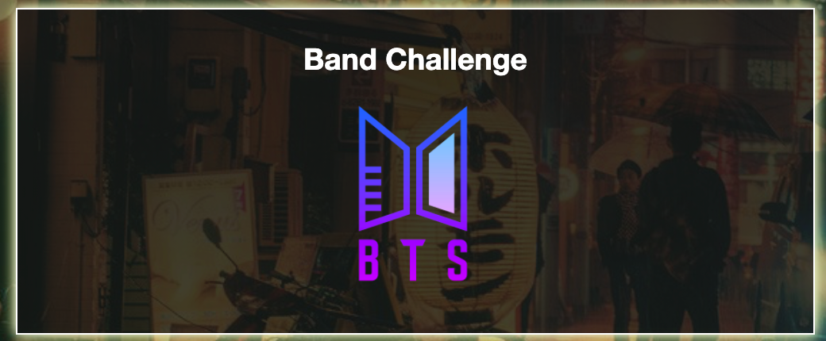

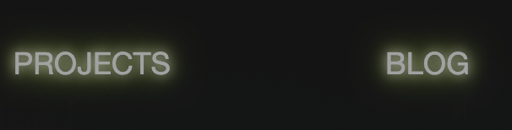
Audience Engagement
“Breathing” effect added to logo to arouse curiosity of audience which triggers mouse over effect in aforementioned nav bar :hover effect
Mouse over effect on project icon to prompt clicks by audience

Slide 24
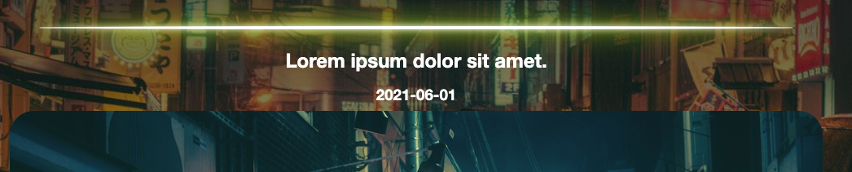
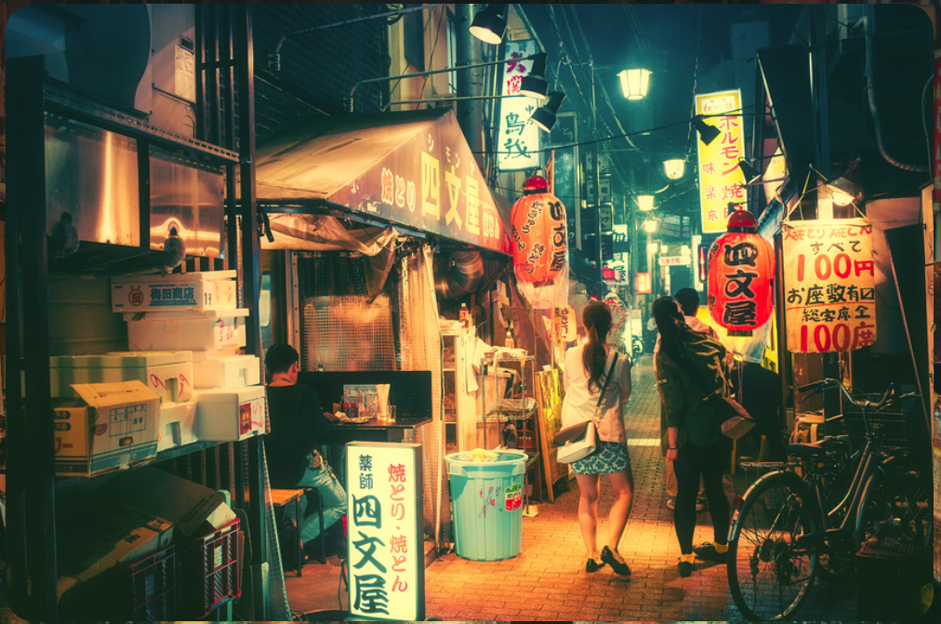
Audience Engagement .cont
“Neon light” design to represent a neon light above each blog post (personal theme)
Mouse over zoom / scale up effect on blog images in attempt to draw attention to audience to view images

Slide 25
Challenges, Issues and Favourite Parts
Challenges
Layout and alignment
Visual Design Aspect
CSS Interference
Responsiveness of overall site
Home Page
Issues
Initial stages, felt like most websites had same layout
Setting up Structure of HTML from scratch
Background-attachment: fixed doesn’t work on some phone browsers
Didn’t Know how to incorporate JS for effects
Favourite Parts
Animations
User interaction effects
Home Page

Slide 26
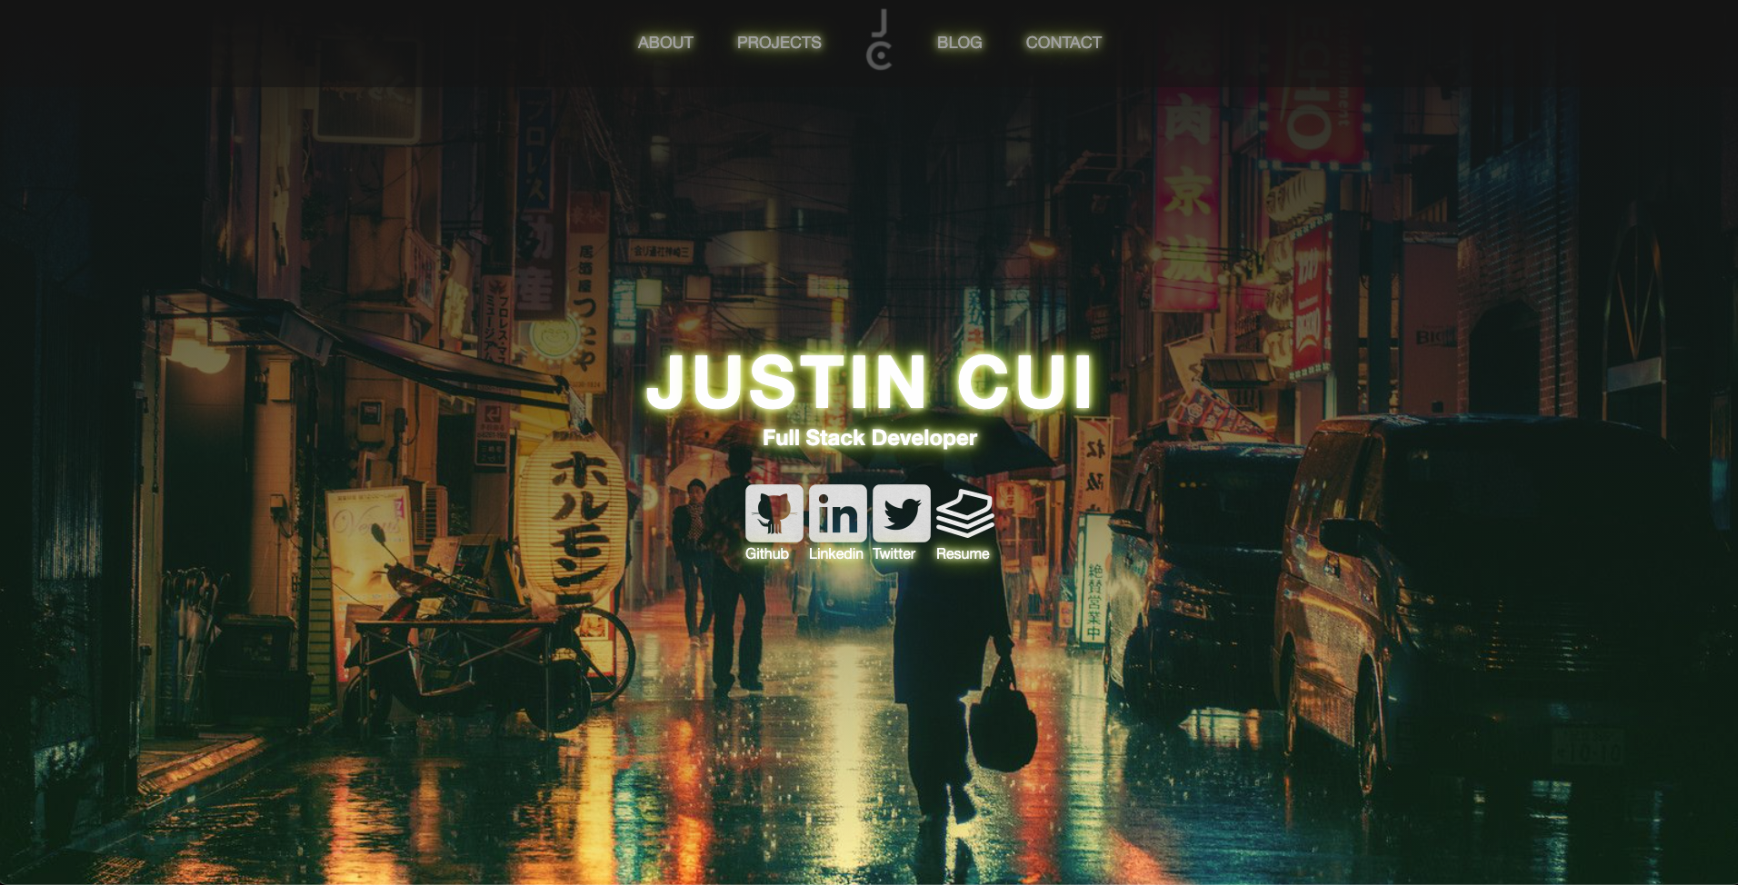

Slide 27
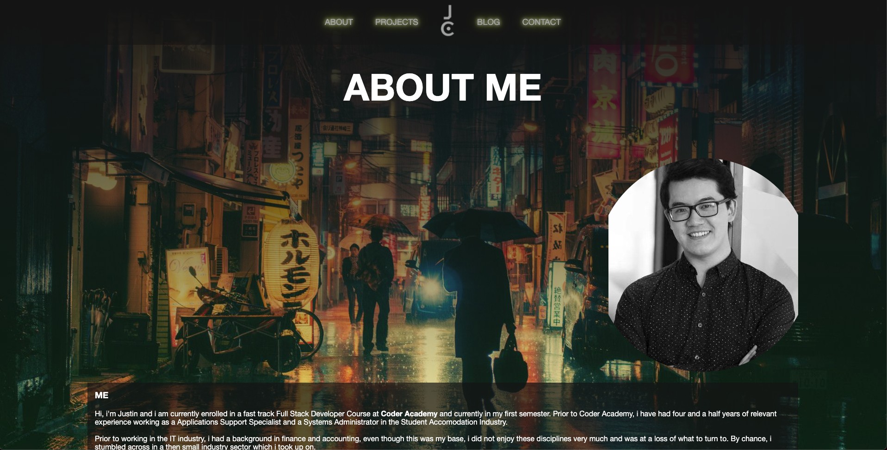

Slide 28
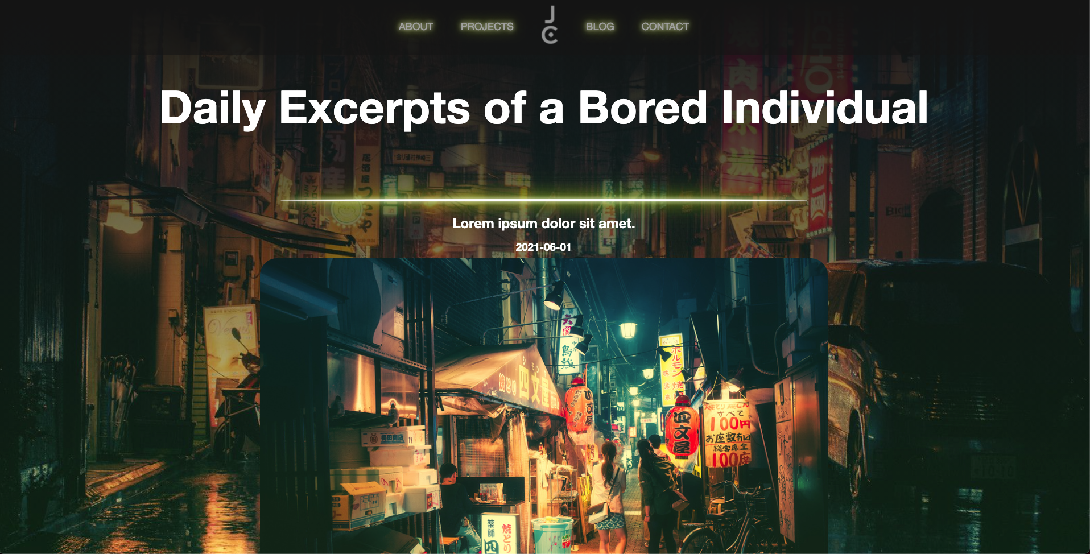

Slide 29
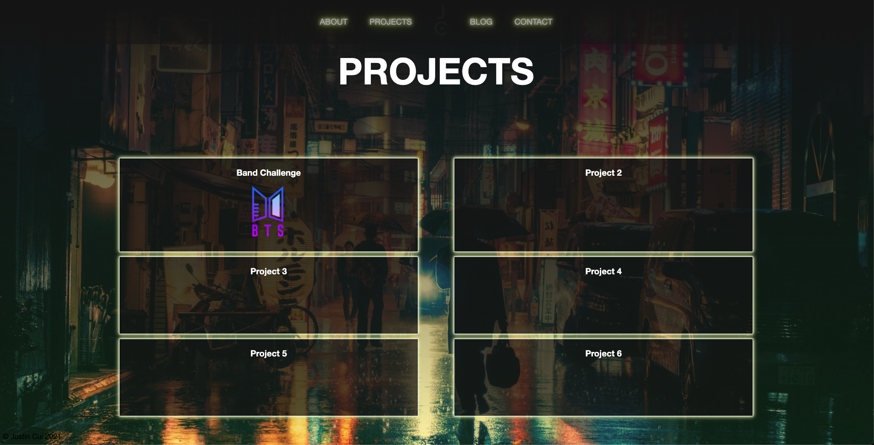

Slide 30
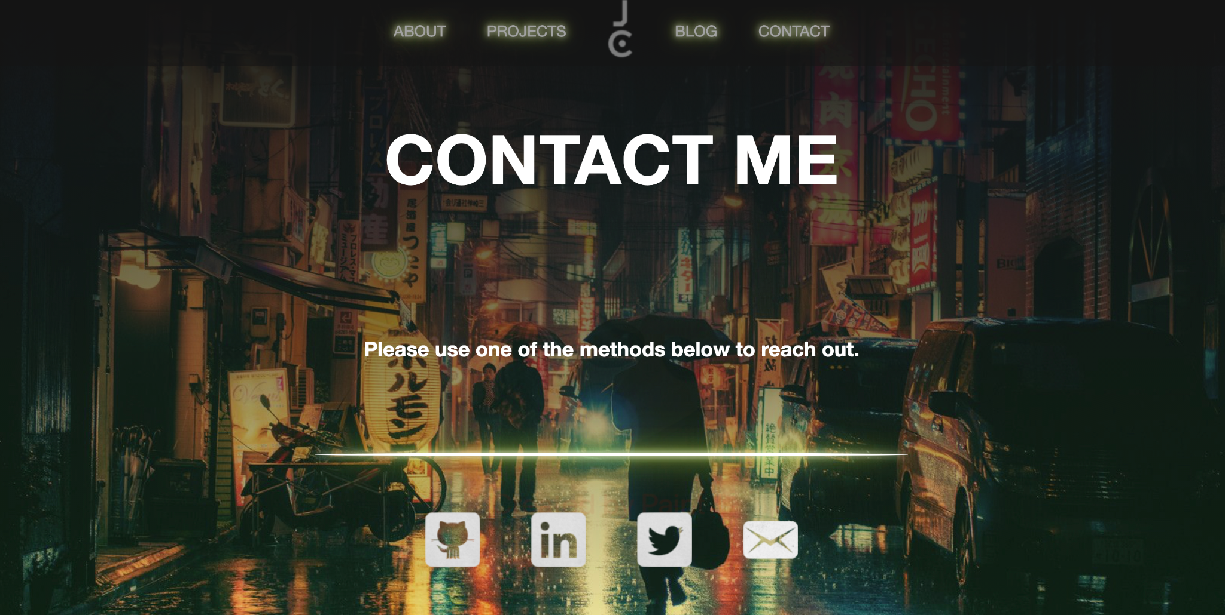

Slide 31
Thank You
:)

